Slide 1
Allevo to provide open-source financial transactions processing application

Slide 2

Agenda
1
2
3
4
Setting the scene
What’s in for Allevo?
What’s in for the customer?
Wrap-up

Slide 3
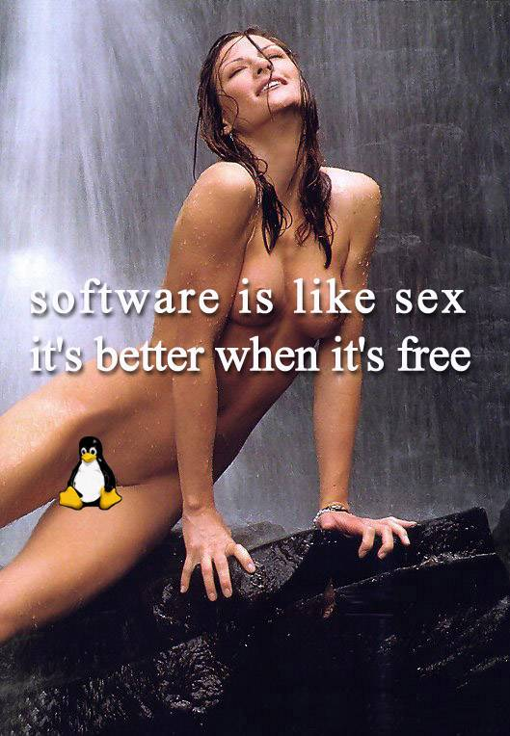
Setting the scene
mentor
trust
It’s even better with
open source
community
product

Slide 4

What’s in for Allevo?
  Latest technologies and recurring updates shared in the community
  Freeing up resources for innovation
  Increased sales in ancillary areas that are business related, like
    bank’s treasury
    corporate or retail customers service
Captive to own product

Slide 5
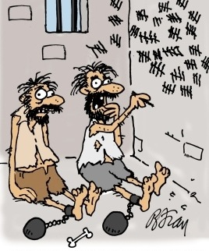
What’s in for the customer?
  Lower dependency on ISV
  If active part of the community - cost sharing for both new developments and recurring software maintenance
  Lays the ground for true competitive advantage, by tuned implementation of the customer’s business architecture
  Cost savings

Slide 6
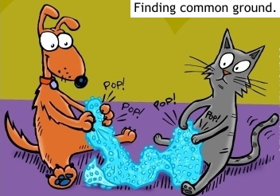
Wrap-up
  Allevo is going to:
  Invest in tools and qPI readiness for openly share the source code
    The qPI core & selected features
    Maintain & enrich qPI certification with SWIFT
    Planned availability: Sibos 2013
  Invest to create the community

Slide 7
Contact
  Please contact us for more detailed information
Partnership frame: Răsvan Stănescu (rasvan.stanescu@allevo.ro)
Sales: Ion Ştirbăţ (ion.stirbat@allevo.ro)
Product Development: Horia Beşchea (horia.beschea@allevo.ro)
Professional Services: Sorina Bera (sorina.bera@allevo.ro)
Business contact: Dan Anghelescu (dan.anghelescu@allevo.ro)
Phone/fax: (4021) 2554-577(8,9)
Allevo Website: www.allevo.ro
Allevo blog: www.allevo.ro/company/blog.aspx
Allevo twitter: http://twitter.com/A11evo

