Slide 1
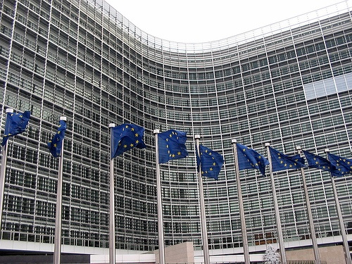
SEPA – Regulation on end dates
1

Slide 2







A complex web of influencers
Rather strict on MIF (SDD) and short timelines for end of migration. Insists on delegated powers for ensuring swift reaction for changes and innovation.
ECB excludes the HVPS.
More end customer focused, proposes gradual MIF ban over time and proposes one date for end of migration (Feb 2014)
EU Commission and ECB / Eurosystem
Regulation
Hungarian
EU Council Presidency
EU Parliament
Banks
Try and push back MIF ban, en dates, mandatory features and powers given to the Commission to change technical requirements
Compromise text comes back mainly on exclusion of HVPS and MIF ban as from 2012.
Industry Stakeholders & lobbies

Slide 3
Short term calendar for negotiations
17/03/11
HU Presidency compromise text on SEPA
end date regulation – Published
ECON Committee (EU Parliament) draft report
ECB/EuroSystem Legal Opinion
Hearing on SEPA in European Parliament
ECON report expected
Deadline for amendments to regulation
Planned adoption in ECON and Parliament plenary
Final ratification of the Regulation (EP Plenary)
28/03/11*
07/04/11
13/04/11
21/04/11
16/05/11*
Today
27/06/11*
12/09/11*
* Tentative timetable

Slide 4
SEPA Regulation - Likely final compromise
  Sets end date for current national euro retail credit transfers and direct debits
      end Jan 2013 (Credit Transfers) and
      end Jan 2014 (for Direct Debits)
  Excludes HVPS from the Regulation but ECB/Eurosystem appetite for migration in line with T2S calendar (end 2014)
  Imposes ISO 20022 XML standard for euro retail CT and DD messages for the interbank space and after a transition period, for customers sending or receiving bulk files
  → Makes the use of IBAN and BIC mandatory **
  → Introduces a strict ban on per transaction Multilateral Interchange Fees (MIFs) for DDs*** as from 2012 for X-border and 2018 for Domestic transactions. Only allows cost-based fees for R-transactions (returns, rejects, refusals, reversals).
* Planned adoption of final compromise text by Parliament and Council is 27 June 2011.
** BBAN–IBAN conversion will still be allowed for national payment transactions during a transition period.
*** The regulation supplements regulation 924/2009 on equality of charges.
**** Position taken at ECON Committee discussion on 20 April 2011

Slide 5
“SEPA means SWIFT”
LVP MIs evolution
Significant growth for early adopters (+25% volumes 2010 vs. 2009 on average)
Segment distribution
Participants to LVP MIs
Domestic traffic is 90% vs. 10% cross border (on SWIFT)
44 new users in 2010 on RPS and EBA for +55 mio pmts/year
Bank-to-MI business is 94% vs.
172 customers growing at more than 18% (+1.1 bio pmts/year)
Slower but tangible evolution of more recent LVP MIs
At least 33% of the volumes are SEPA with a steady growth
Healthy and significant volumes of retail payments over SWIFTNet FA (est. 550 million payments/month)
Steep growth of FA traffic provoked by LVP Mis 2011 YTD (+32%)
6% for inter-MI business (EACHA and EBA STEP2 volumes)

