Slide 1
PAYaaS
Payments as a Service in the B2B and C2B Space
June 09, 2011

Slide 2
Agenda
1
2
3
4
5
Allevo
Cloud: SaaS, PaaS, IaaS
qPayIntegrator
PAYaaS
PROs and CONs

Slide 3

In a Nutshell
is a private Romanian software vendor and consultancy company focused on reliably ensuring the exchange of value-related messages
More to the point, we deliver innovative solutions and services for real-time payments processing, empowering financial institutions and corporate to:
improve / re-structure / centralize their payments systems
align the payments to international standards
automate the payments flow

Slide 4








Profile
SWIFT Ready Application Provider
SWIFT Ready Service Provider
Allevo Solutions
Allevo Services
qPayIntegrator
  Real-time payment suite
  Process and
  resource management
  Business continuity
  Business analysts
  Implementation engineers
Solution Experts
Esfera
Technical Experts
FMA

Slide 5


Rebranding
June 7, 2011

Slide 6
Cloud
Software as a Service
Platform as a Service
Infrastructure as a Service

Slide 7
Cloud (cont.)

Slide 8
Cloud (cont.)
* Data from Forrester Research, Cloudscaling, Cloudkick

Slide 9
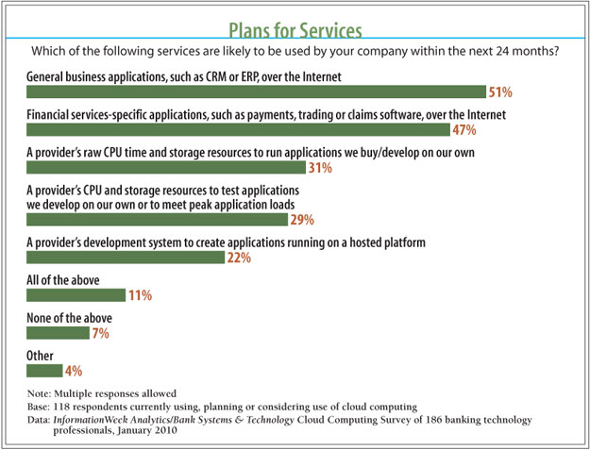
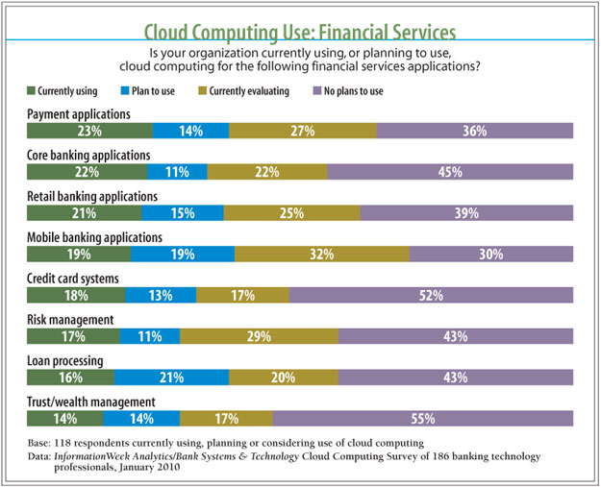
Cloud (cont.)
Banks Systems and Technology - 2010 Survey on Cloud Computing

Slide 10
Payment Institutions (PIs)
PSD
http://en.wikipedia.org/wiki/Payment_Services_Directive
http://www.bnr.ro/Institutii-de-plata-4993.aspx
Payment Institutions (PIs)
The PSD identifies a new type of institution (“Payment Institutions” – PIs). PIs must be authorised to provide and execute payment services; once authorisation has been granted in one Member State, a PI is allowed to offer the same payment services throughout the EU/EEA.
With regard to this new category of payment service provider, the PSD specifies
Authorisation, i. e. application, procedure, maintenance, withdrawal;
Capital requirements for PIs;
Safeguarding (or ring-fencing) requirements;
Registration, record-keeping;
Use of agents;
Supervision of PIs by competent authorities.
One of the Directive’s objectives is to promote competition in Europe, in particular by ensuring that the rules governing PSPs’ access to payment systems are objective, non-discriminatory and proportionate (Art. 28).

Slide 11
Payment Institutions (PIs)
Country | No. of authorised PIs | No. of PIs applications
Belgium | 1 | 19
Bulgaria | 9
Cyprus | 2
Czech Republic |  | 8
Denmark | 1
Finland | 2
France | 2 | 5
Germany | 16
Greece |  | 10
Hungary | 2
Ireland | 10
Italy | 1
Lithuania |  | 5
Luxembourg | 1
Malta | 1
Netherlands | 1
Portugal | 0
Romania | 1
Slovakia | 1
Slovenia |  | 5
Spain | 1 | 4
Sweden |  | 3
UK | 79
TOTAL | 131 | 59
Source: SEPA Paypers, vol. 4 Issue 2.

Slide 12

Highlights
qPayIntegrator
Real time funds transfer management and processing application, with a core providing:
- technical integration between different business applications
- data conversions to/from different formats
- message routing and archiving
- duplicate detection and investigation
qPI-ML: Real-time cash reports and forecasts
ReconS: Accounting reconciliation
qPI-AML: Transactions filtering
qPI-TR: Competitive reports and early alerts
qPI-FMA: Resilience & monitoring
PAYaaS: Fully managed online service
1st solution awarded SWIFTReady SEPA 2008 certification
Re-certified SWIFTReady SEPA 2009
Letter of conformance for SWIFT Workers’ Remittances 2010
qPI-SEP: Access to market infrastructures
qPI-DD: Direct Debit processing
qPI-DI: Debit Instruments processing
qPI-SEPA: SCT & SDD compliance
qPI-WR: Remittances management
qPI-AT: Automatic testing

Slide 13
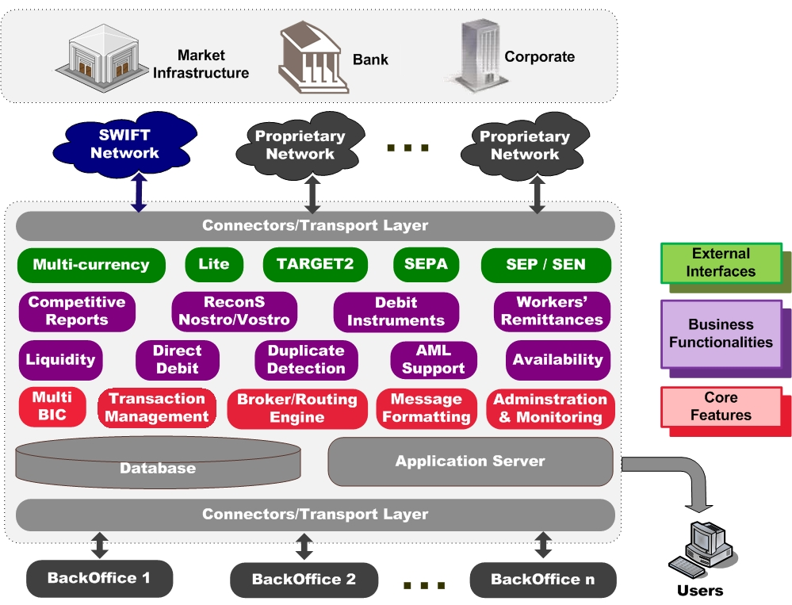
Outline

Slide 14

Solutions
For Banks
For Microfinance Institutions
For State Treasuries
For Corporations
For Service Bureaus

Slide 15
Evolution
Open Source
  Shared sources qPI-OpenS
Financial Services
  Shared platform PAYaaS
Client-oriented Features
  Corp2Bank space qPI-Lite
  Pers2Pers space qPI-WR
Business Features
  Liquidity reporting qPI-ML
  Reconciliation ReconS
  Competitive reports qPI-TR
  AML Filtering qPI-AML
Payment System
  Middleware between BO apps and market infrastructures (routing, formatting, dup.det. etc.) qPI

Slide 16




Positioning
Market
Infrastructure
Bank
Corporate
SWIFT
Network
Proprietary
Network(s)
qPayIntegrator
Bank /
Corporate
Back-office(s) / ERP(s)

Slide 17
SaaS (PAYaaS) Positioning
Market
Infrastructure
Bank
Corporate
SWIFT
Network
Proprietary
Network(s)
SWIFT Platform
qPayIntegrator
Service
Bureau
Bank /
Corporate
Back-office(s) / ERP(s)

Slide 18
PAYaaS Packaging
Current focus on
Secure Internet Access
Corporate access to SWIFT
E&I
Connection with other CSMs
Packages
Payments/collections (including SEPA & TARGET2 compliance)
AML filtering
ReconS
Workers’ Remittances
Centralized payment system (for corporate)

Slide 19
Using PAYaaS
Look & Feel (www.payaas.bisnet.ro)
General service description
Demo (user registration required)
Trial (user registration required)
Private network installed (VPN/SSL/PKI)
Production (+ test, backup, pre-live environment)
Dedicated administrative network
Dedicated users environment (qPI instance included)

Slide 20
Costs Comparison
- Costs per usage (OPEX):
1. per transaction for standard traffic
2. per day (for cash reporting)
3. per account (for reconciliation)
4. per message (for AML filtering)
- No recurring costs (e.g. software maintenance, SLA)
- No infrastructure needed
- No infrastructure level administrators needed
- No administrators costs
- Initial licensing (CAPEX):
1. qPI-TIP (core)
2. qPI-ML (cash reporting)
3. ReconS (accounting reconciliation)
4. AML filtering
- Recurring costs (e.g. software maintenance, SLA)
- Hardware/software platform
- Infrastructure level administrators (operating systems, database etc.)
- Business application administrators
PAYaaS costs structure
Current costs structure

Slide 21
Before making a decision…
Trusted third parties?
Fallback for internet?
Data security, no compromise!
SLA guarantees with reporting services
Migration strategies
Integration requirements

Slide 22
PROs
Plug-and-play
Cost reduction
Business focus
You can connect to the offered infrastructure and start working immediately
No initial investment in licensing and hardware acquisition
No concern about recurrent alignment to standards and regulations, or about last version updates
No infrastructure & maintenance personnel costs
No need to upgrade or modernize the system
You’ll be able to concentrate on the core business

Slide 23
Contact
  Please contact us for more detailed information
Partnership frame: Răsvan Stănescu (rasvan.stanescu@allevo.ro)
Sales: Ion Ştirbăţ (ion.stirbat@allevo.ro)
Product Development: Horia Beşchea (horia.beschea@allevo.ro)
Professional Services: Sorina Bera (sorina.bera@allevo.ro)
Business contact: Dan Anghelescu (dan.anghelescu@allevo.ro)
Phone/fax: (4021) 2554-577(8,9)
Allevo website: http://www.allevo.ro
Allevo blog: http://www.allevo.ro/company/blog.aspx
Allevo twitter: http://twitter.com/A11evo

